Slide 1
Business Process Modelling & Enterprise Architecture
And
Advanced Information Systems Development
Version Control
Rumali Sirimanne

Slide 2
Session Plan
Versioning Tasks and Concepts
Example Scenario and Github

Slide 3
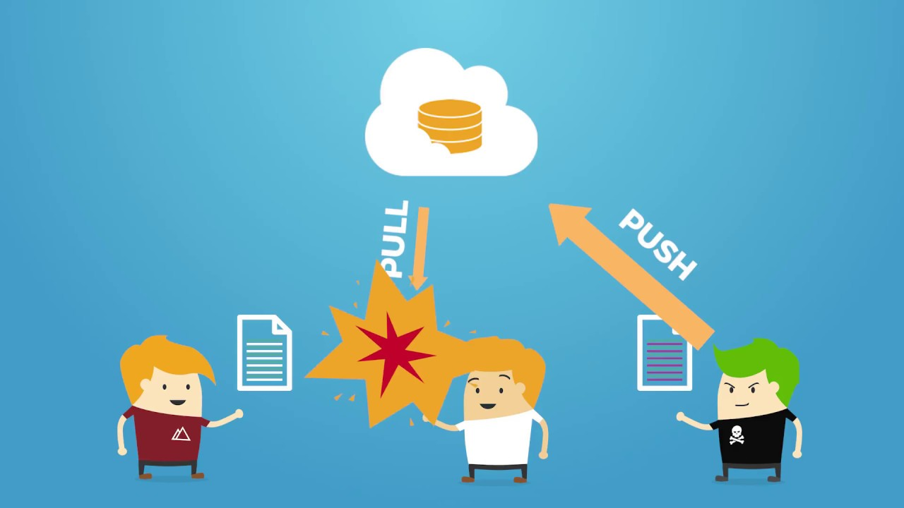
Basic Concepts of Versioning
Projects
Revisions
Branches
Merging
Conflicts

Slide 4
Projects
A project is a set of files in version control
  Called a module in CVS
Version control doesn’t care what files
  Not a build system
  Or a test system
    Though there are often hooks to these other systems
  Just manages versions of a collection of files

Slide 5
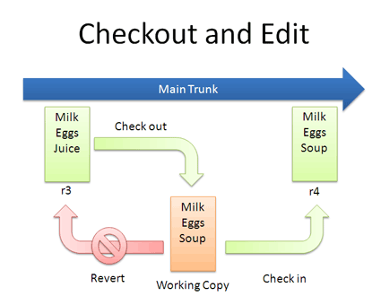
Revisions
Check Out
  If you want to make a change the file needs to be checked out from the repository
Check In
  When changes are completed the new code is checked-in.
Consider
  Check out a file
    Edit it
    Check the file back in
  This creates a new version of the file
  Usually increment minor version number
    E.g., 1.5 -> 1.6

Slide 6
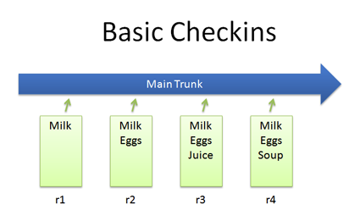
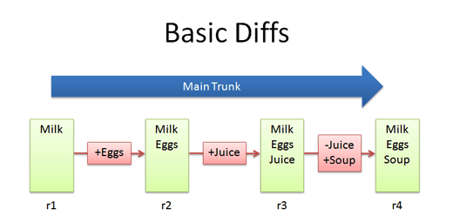
Revision Cont’d
A commit consists of a set of checked in files and the diff between the new and parent versions of each file.
Each check-in is accompanied by a user name and other meta data.

Slide 7
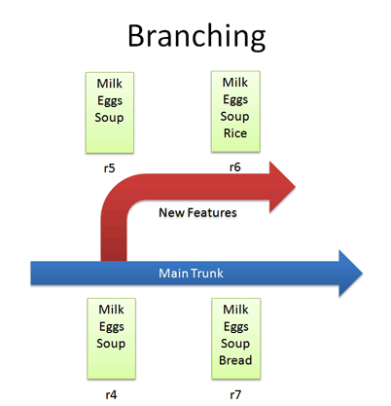
Branches
A branch is just two revisions of a file
  Two people check out 1.5
  Check in 1.5.1
  Check in 1.5.2
Notes
  Normally checking in does not create a branch
    Changes merged into main code line
Must explicitly ask to create a branch

Slide 8
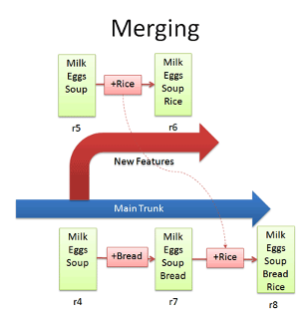
Merging
There are occasions when multiple versions of a file need to be collapsed into a single version.
  E.g. A feature from one branch is required in another
This process is known as a merge.
Difficult and dangerous to do in CVS
Easy and cheap to do in git

Slide 9
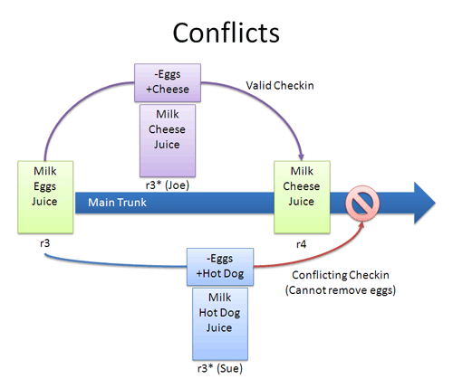
Conflicts
Arise when two programmers edit the same piece of code
One change overwrites another
The system doesn’t know what should be done, and so complains of a conflict.
Conflicts must be resolved by hand

Slide 10
Example Scenario and Github

Slide 11
Scenario Bug Fix
Time
First public release of the hot new product
Releases
1.0

Slide 12
Scenario Bug Fix
Time
Internal development continues, progressing to version 1.3
Releases
1.0
1.3

Slide 13
Scenario Bug Fix
Time
A fatal bug is discovered in the product (1.0), but 1.3 is not stable enough to release. Solution: Create a version based on 1.0 with the bug fix.
Releases
1.0
1.3
1.0 bugfix

Slide 14
Scenario Bug Fix
Time
Note that there are now two lines of development beginning at 1.0.
This is branching.
Releases
1.0
1.3
1.0 bugfix

Slide 15
Scenario Bug Fix
Time
The bug fix should also be applied to the main code line so that the next product release has the fix.
Releases
1.0
1.3
1.4
1.0 bugfix

Slide 16
Scenario Bug Fix
Time
Note that two separate lines of development come back together in 1.4.
This is merging or updating.
Releases
1.0
1.3
1.4
1.0 bugfix

Slide 17
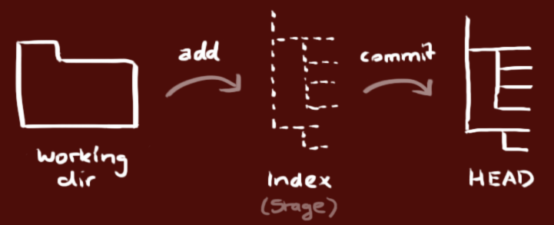
Using a Git Repository
Workflow
  your local repository consists of three "trees" maintained by git.
  the first one is your Working Directory which holds the actual files.
  the second one is the Index which acts as a staging area
  the third one is the HEAD which points to the last commit you've made.

Slide 18

Using a Git Repository
Create a new (Local) Repository
  create a new directory and initialise
    git init
Check out a Repository
  git clone /path/to/repository
  git clone username@host:/path/to/repository
Propose Changes to Index
  git add <filename>
  git add *
Commit Changes
  git commit -m "Commit message”
Push Changes (to master branch)
  git push origin master
Update local repository to newest commit
  git pull

Slide 19
References and Further Reading
https://betterexplained.com/articles/a-visual-guide-to-version-control/
http://rogerdudler.github.io/git-guide/

Slide 20
Business Process Modelling & Enterprise Architecture
And
Advanced Information Systems Development
Version Control
Rumali Sirimanne

